Slide 1
Supervised condensate detection
Protein-level views plus TDP43 WT/12D condition trials
18,671
6
13
0
tracks in final control-guided table
proteins shown separately
TDP43 condition folders inventoried
target-specific trapping-like calls
TDP43 condition slides use completed per-folder condensate_evaluation outputs; missing repeats are explicitly labeled.
Supervised condensate detection: protein-level views
01

Slide 2
ALL PROTEINS
Protein-level overview
free-like
chromatin-bound-like
MCM-bound-like
ambiguous
target-specific
H2B
8,476 tracks
0.0% ambiguous
MCM2
2,661 tracks
11.8% ambiguous
MCM2_Bound
178 tracks
0.0% ambiguous
NLS
718 tracks
0.0% ambiguous
NONO
3,673 tracks
11.9% ambiguous
TDP43
2,965 tracks
12.6% ambiguous
Every target-specific segment is zero; the strongest target signal is therefore the ambiguous/manual-review pool.
Supervised condensate detection: protein-level views
02

Slide 3
SEPARATED PROTEIN SLIDE
H2B protein-level view
8,476
3.9%
96.1%
0.0%
total tracks
free-like
chromatin-bound-like
ambiguous
free
chromatin
MCM-bound
ambiguous
target-specific
MCM-bound-like 0.0% | target-specific 0.0% | median max dwell 22 frames
Almost all H2B tracks are chromatin-bound-like, matching its role as the chromatin reference.
Supervised condensate detection: protein-level views
03

Slide 4
SEPARATED PROTEIN SLIDE
MCM2 protein-level view
2,661
23.1%
62.3%
11.8%
total tracks
free-like
chromatin-bound-like
ambiguous
free
chromatin
MCM-bound
ambiguous
target-specific
MCM-bound-like 2.7% | target-specific 0.0% | median max dwell 24 frames
Bulk MCM2 is mixed across free-like, chromatin-bound-like, and ambiguous bins.
Supervised condensate detection: protein-level views
04

Slide 5
SEPARATED PROTEIN SLIDE
MCM2_Bound protein-level view
178
0.0%
0.0%
0.0%
total tracks
free-like
chromatin-bound-like
ambiguous
free
chromatin
MCM-bound
ambiguous
target-specific
MCM-bound-like 100.0% | target-specific 0.0% | median max dwell not available
High-confidence MCM2_Bound acts as the replication/chromatin-associated bound reference.
Supervised condensate detection: protein-level views
05

Slide 6
SEPARATED PROTEIN SLIDE
NLS protein-level view
718
100.0%
0.0%
0.0%
total tracks
free-like
chromatin-bound-like
ambiguous
free
chromatin
MCM-bound
ambiguous
target-specific
MCM-bound-like 0.0% | target-specific 0.0% | median max dwell 19 frames
NLS anchors the free-like nuclear-motion reference.
Supervised condensate detection: protein-level views
06

Slide 7
SEPARATED PROTEIN SLIDE
NONO protein-level view
3,673
6.5%
78.3%
11.9%
total tracks
free-like
chromatin-bound-like
ambiguous
free
chromatin
MCM-bound
ambiguous
target-specific
MCM-bound-like 3.4% | target-specific 0.0% | median max dwell 20 frames
NONO targets mainly fall into chromatin-bound-like or ambiguous categories.
Supervised condensate detection: protein-level views
07

Slide 8
SEPARATED PROTEIN SLIDE
TDP43 protein-level view
2,965
25.5%
59.6%
12.6%
total tracks
free-like
chromatin-bound-like
ambiguous
free
chromatin
MCM-bound
ambiguous
target-specific
MCM-bound-like 2.3% | target-specific 0.0% | median max dwell 21 frames
TDP43 has more free-like calls than NONO, but still no target-specific trapping-like calls.
Supervised condensate detection: protein-level views
08

Slide 9
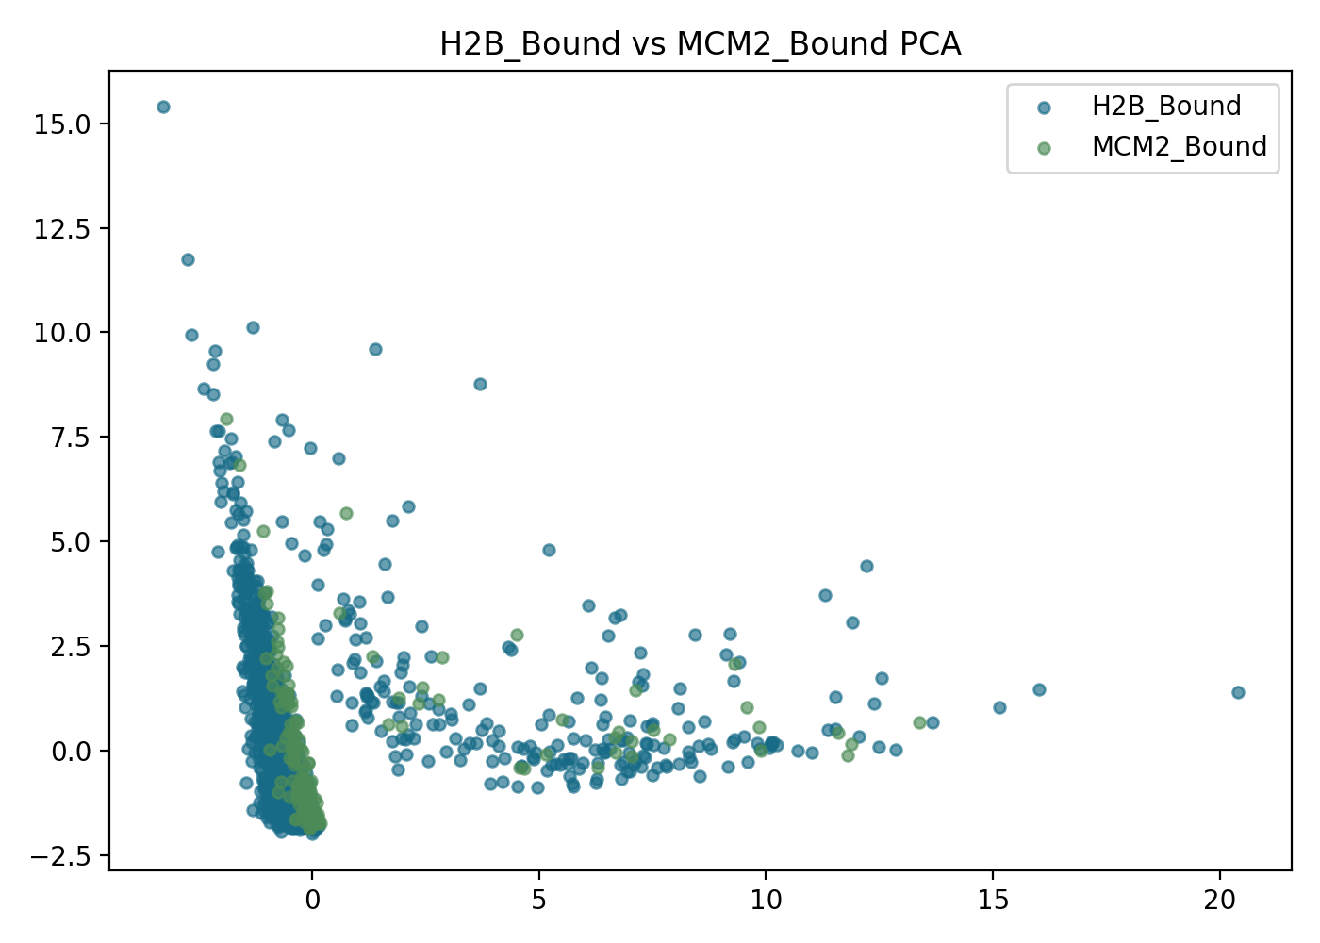
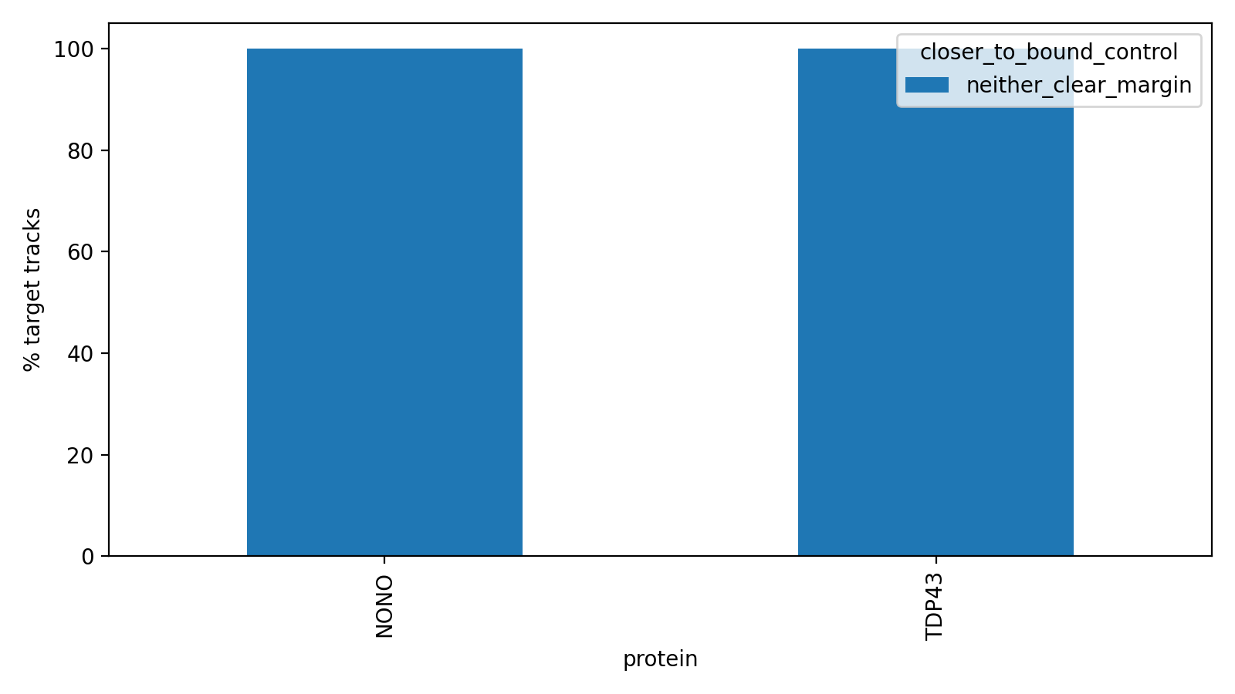
H2B_BOUND VS MCM2_BOUND
Bound-control diagnostic context
H2B_Bound and MCM2_Bound are partly separable, not identical.
TDP43 and NONO sit near the boundary, with a small MCM2_Bound-like tilt.
This supports cautious control-guided wording rather than definitive localization claims.
09
Supervised condensate detection: protein-level views

Slide 10
COMPLETED CONDITION OUTPUTS
TDP43 WT individual trials
mixed
old trapping-like
slow diffusive
missing
WT-0416-CT
27.1% old trapping-like; n=667
WT-0423-CT
18.7% old trapping-like; n=246
WT-0515-CT
missing classification output
no completed summary
WT-0416-ARS
26.0% old trapping-like; n=1492
WT-0423-ARS
27.7% old trapping-like; n=830
WT-0515-ARS
missing classification output
no completed summary
WT-1211-ACTD
33.7% old trapping-like; n=199
These are per-folder condensate_evaluation summaries, not new target-specific supervised calls.
Supervised condensate detection: protein-level views
10

Slide 11
COMPLETED CONDITION OUTPUTS
TDP43 12D individual trials
mixed
old trapping-like
slow diffusive
missing
12D-0416-CT
22.7% old trapping-like; n=225
12D-0423-CT
20.6% old trapping-like; n=136
12D-0502-CT
missing classification output
no completed summary
12D-0416-ARS
21.6% old trapping-like; n=1038
12D-0423-ARS
26.9% old trapping-like; n=260
12D-0515-ARS
25.7% old trapping-like; n=377
12D ARS currently has all three completed biological repeats; 12D CT is missing one completed summary.
Supervised condensate detection: protein-level views
11

Slide 12
CONTROL CONDITION
TDP43 CT: individual trials and averages
mixed
old trapping-like
slow diffusive
missing
WT-0416-CT
27.1% old trapping-like
WT-0423-CT
18.7% old trapping-like
WT-0515-CT
missing classification output
missing
12D-0416-CT
22.7% old trapping-like
12D-0423-CT
20.6% old trapping-like
12D-0502-CT
missing classification output
missing
WT CT average
22.9% old trapping-like; 2/3 completed repeats
12D CT average
21.6% old trapping-like; 2/3 completed repeats
Supervised condensate detection: protein-level views
12

Slide 13
ARSENITE CONDITION
TDP43 ARS: individual trials and averages
mixed
old trapping-like
slow diffusive
missing
WT-0416-ARS
26.0% old trapping-like
WT-0423-ARS
27.7% old trapping-like
WT-0515-ARS
missing classification output
missing
12D-0416-ARS
21.6% old trapping-like
12D-0423-ARS
26.9% old trapping-like
12D-0515-ARS
25.7% old trapping-like
WT ARS average
26.9% old trapping-like; 2/3 completed repeats
12D ARS average
24.7% old trapping-like; 3/3 completed repeats
Supervised condensate detection: protein-level views
13

Slide 14
REPEAT-LEVEL CAUTION
TDP43 averaged condition comparison
WT CT
22.9% old trapping-like | 2/3 completed repeats
WT ARS
26.9% old trapping-like | 2/3 completed repeats
12D CT
21.6% old trapping-like | 2/3 completed repeats
12D ARS
24.7% old trapping-like | 3/3 completed repeats
Only 12D ARS currently supports a true 3-repeat average. Other averages are shown from completed outputs and should be treated as provisional.
Supervised condensate detection: protein-level views
14

Slide 15
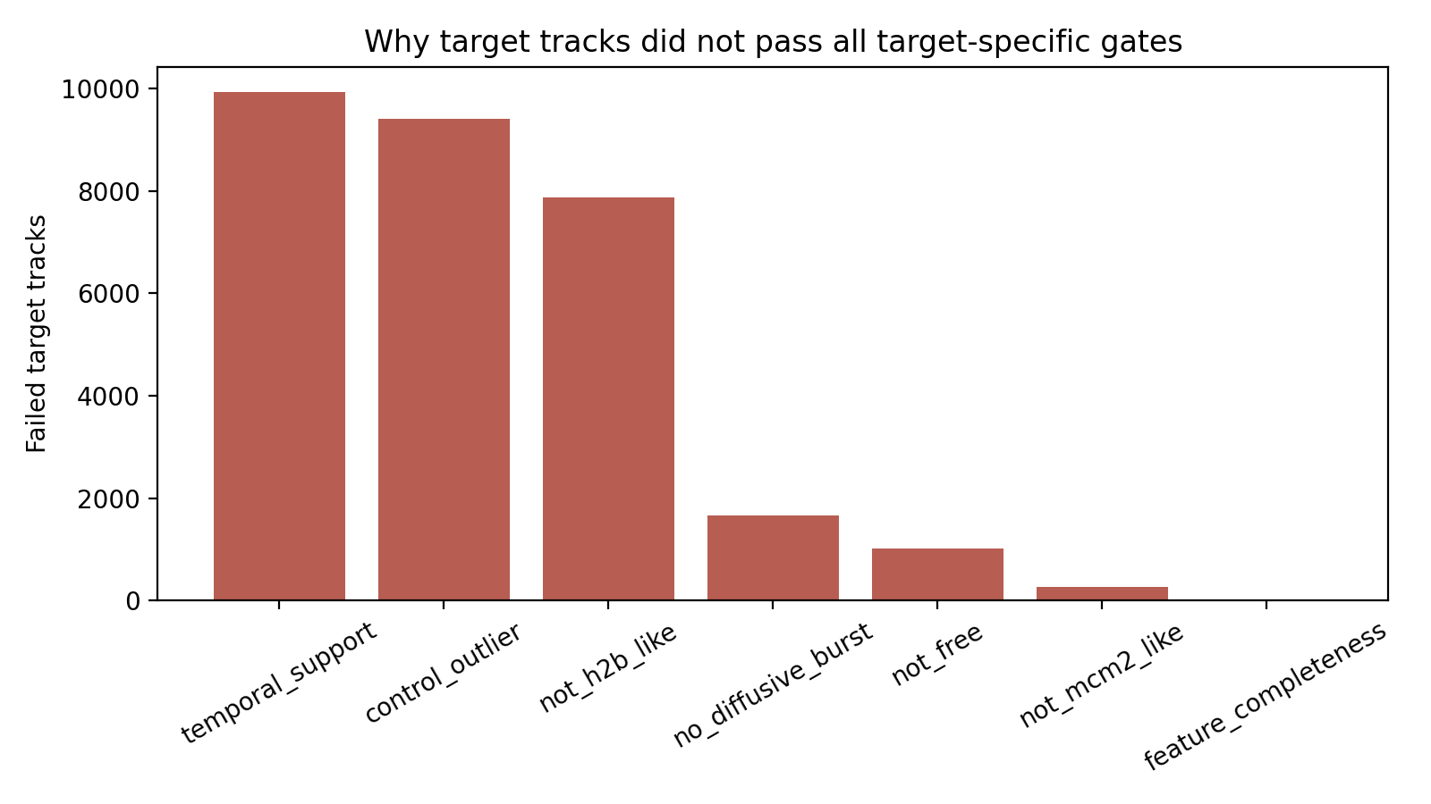
GATE FAILURES
Why target-specific calls stayed at zero
In the final supervised/control-guided output, every TDP43/NONO target failed at least one strict gate.
The dominant bottlenecks were temporal support, control-outlier distinctness, and not-H2B-like behavior.
Per-condition old trapping-like percentages are useful for triage, but do not override the strict gate results.
Supervised condensate detection: protein-level views
15

Slide 16
WHAT CHANGED IN THIS DECK
Interpretation
Added separated protein-level slides for H2B, MCM2, MCM2_Bound, NLS, NONO, and TDP43.
Added TDP43 WT and 12D condition slides with individual completed trials.
Added CT and ARS average slides with repeat-completion status.
Kept cautious wording: tracking supports motion-pattern interpretation, not definitive condensate or paraspeckle localization.
Next analysis batch: rerun missing WT-0515 CT/ARS and 12D-0502 CT outputs through the final supervised classifier before making 3-repeat condition claims.
Supervised condensate detection: protein-level views
16

